Slide 1
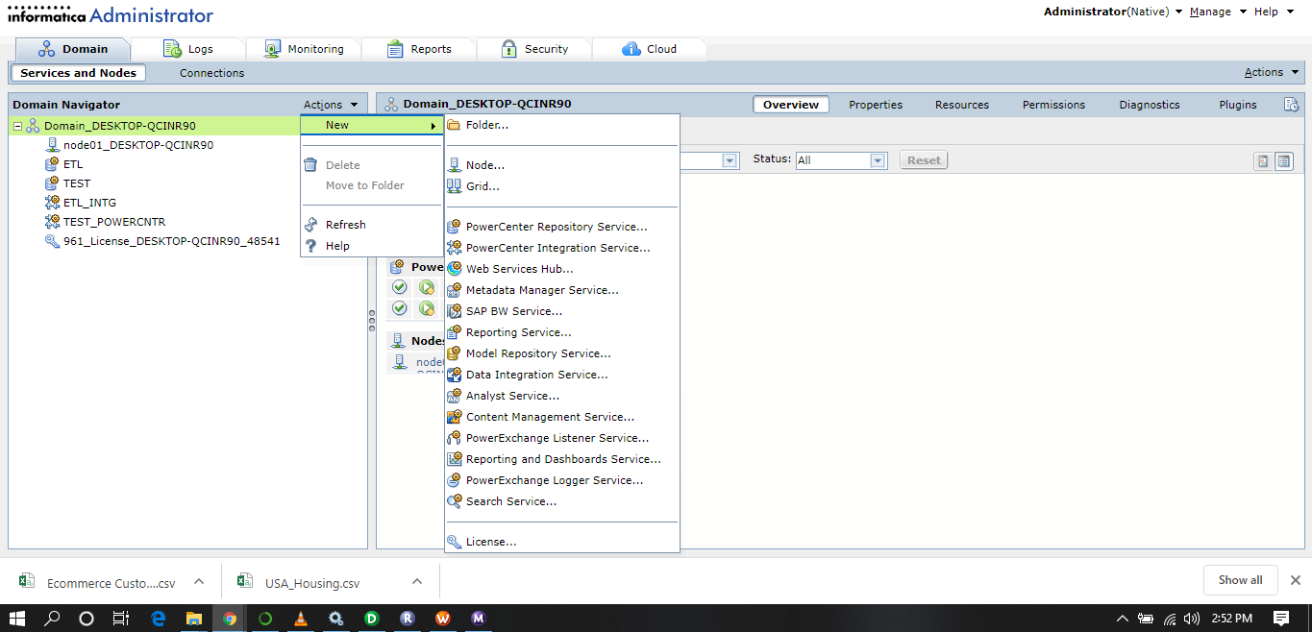
Administration

Slide 2
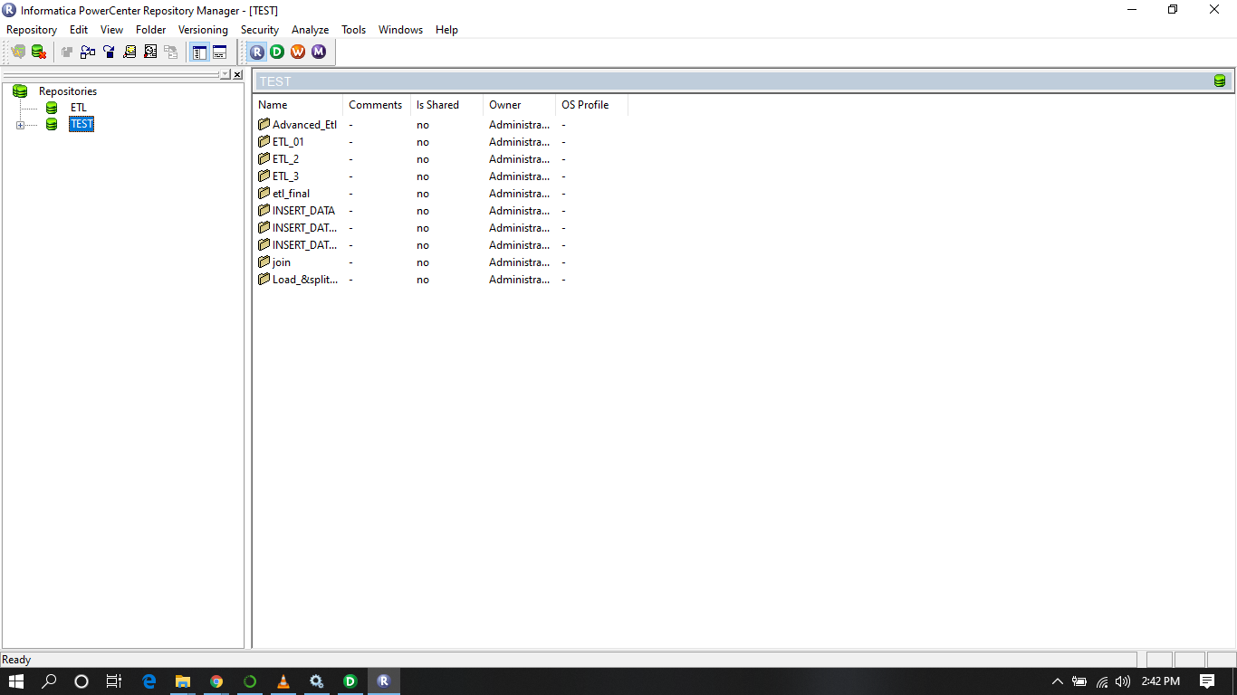
Power center Repo

Slide 3
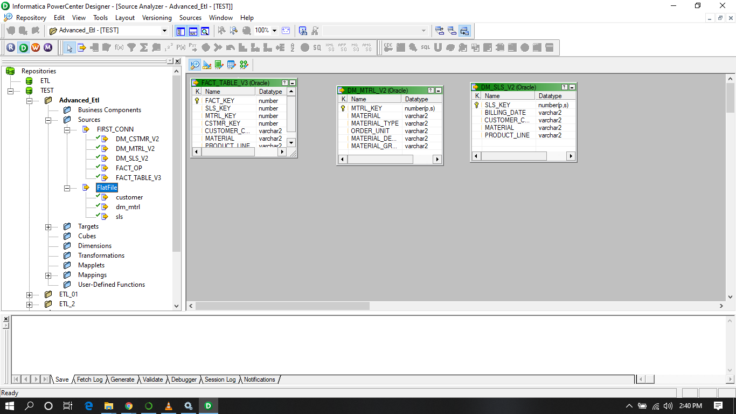
Source Tables(Flat Files)

Slide 4
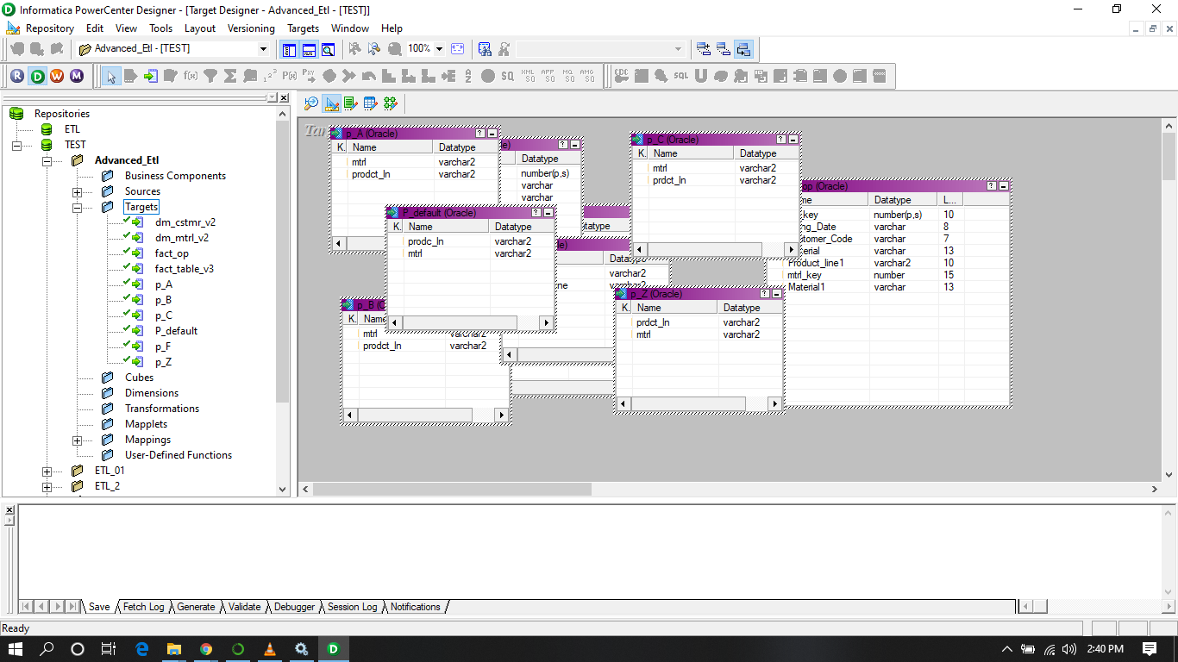
Target Tables(DB)

Slide 5
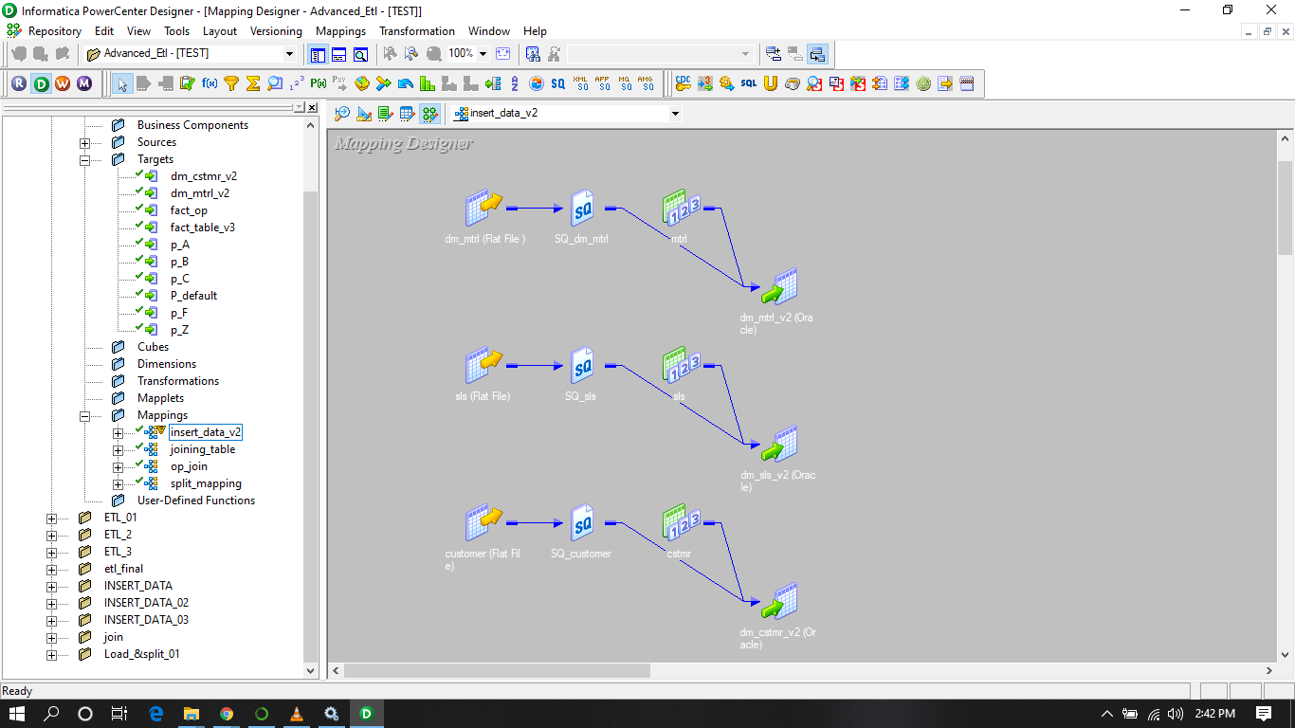
Mapping: Source -> Target(Extract)

Slide 6
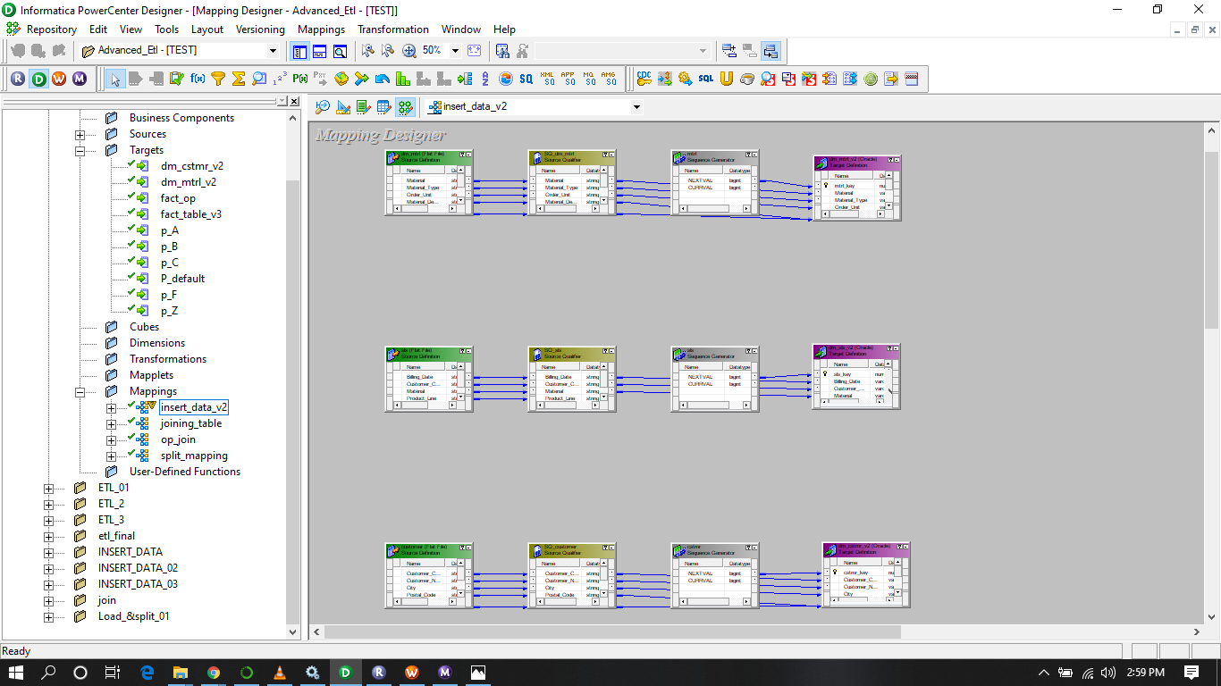
Insert data: Flat file -> DB (Transform)

Slide 7
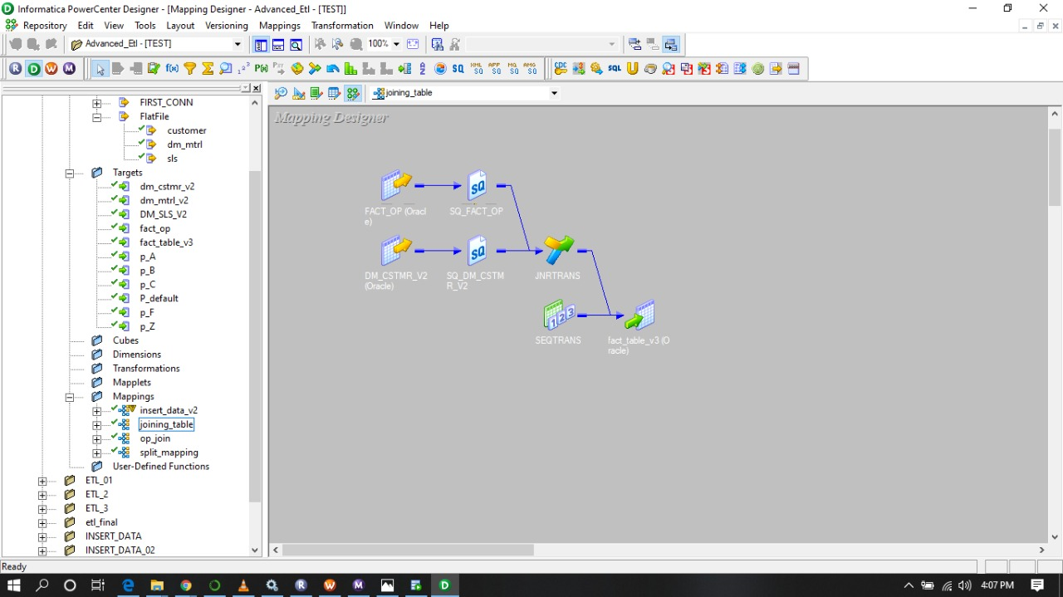
Mapping & Joining(Transform)

Slide 8
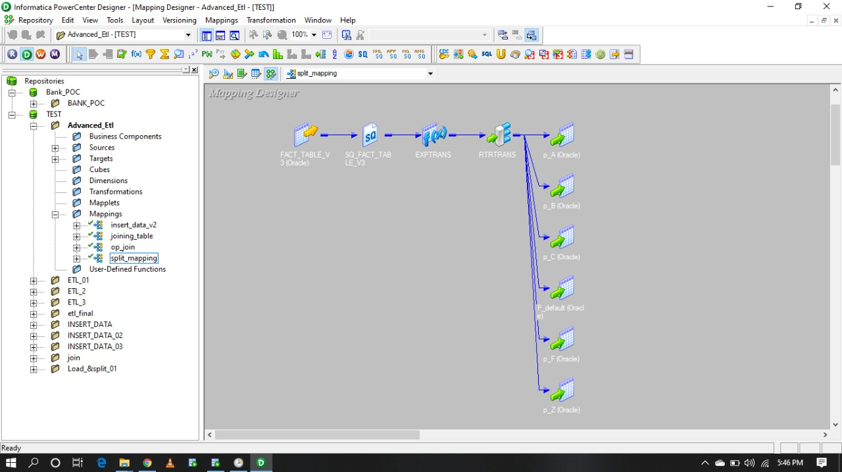
Splitting(Transform)

Slide 9
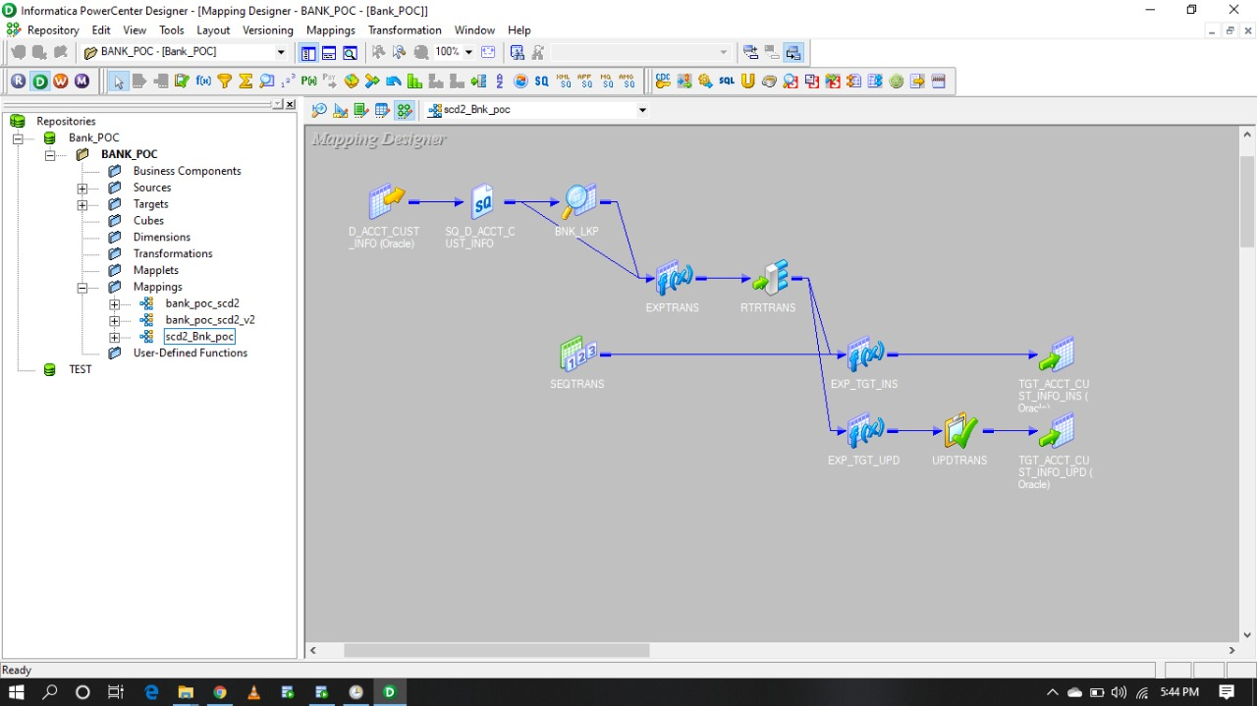
SCD1, SCD2, SCD3 (Transform)

Slide 10
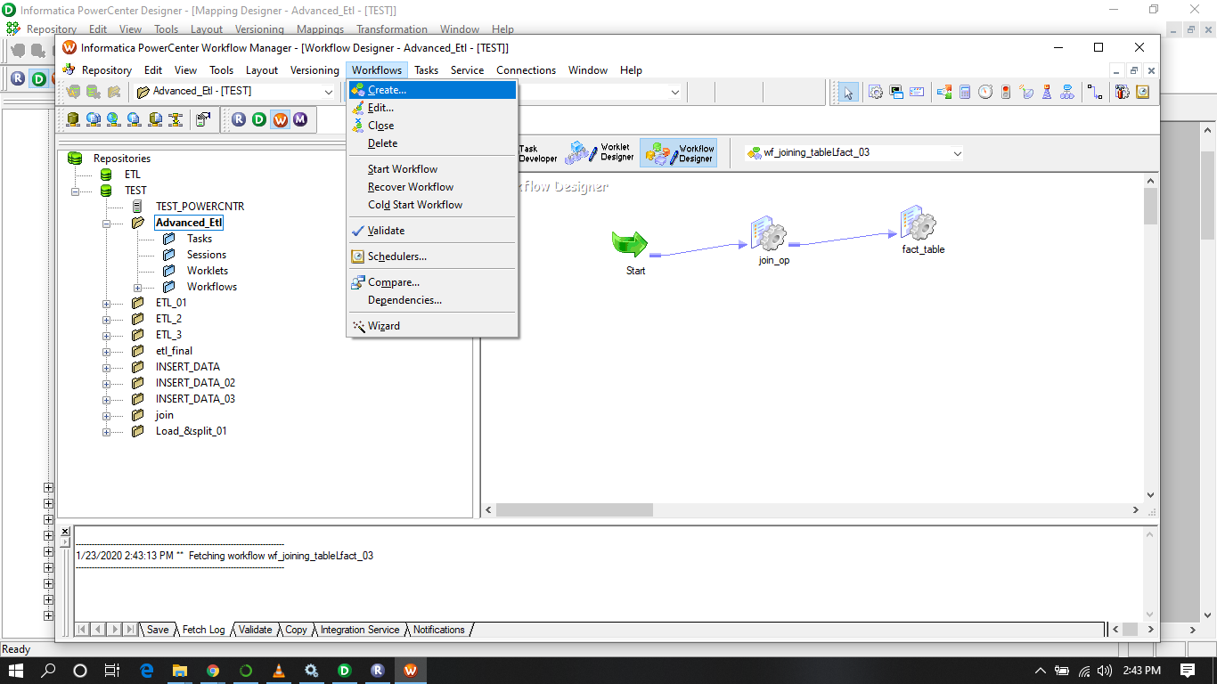
Workflow & Session

Slide 11
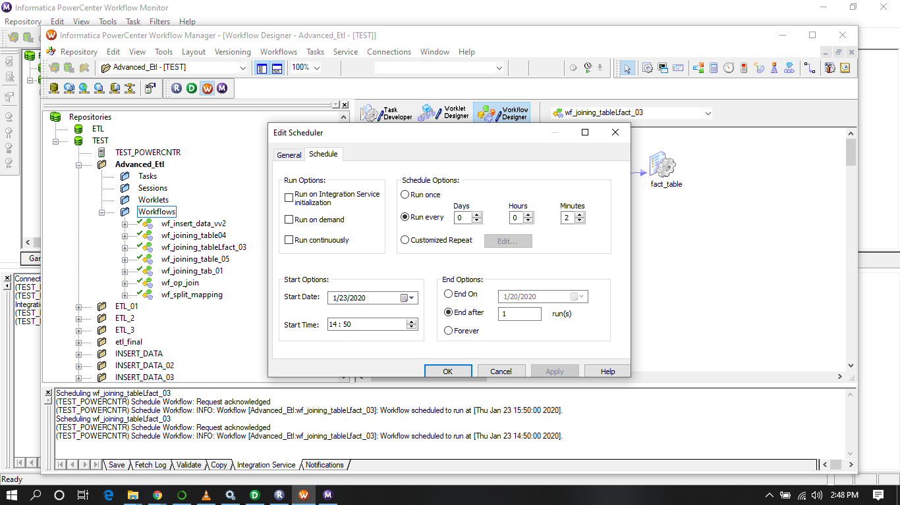
Informatica Scheduler

Slide 12
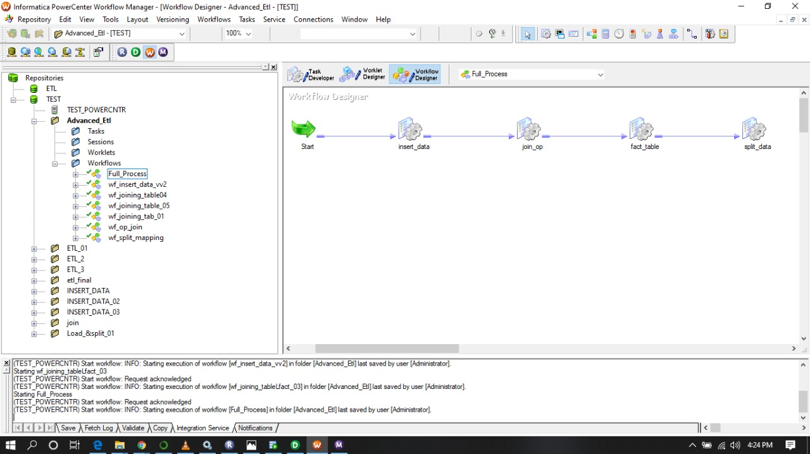
Parallel Processes

Slide 13
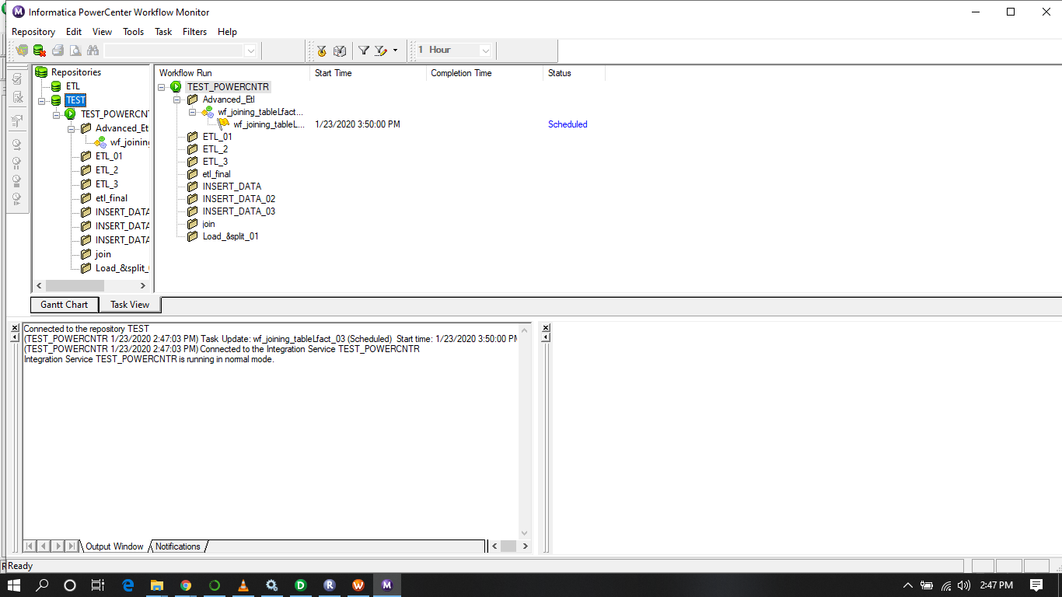
Workflow Monitor

Slide 14
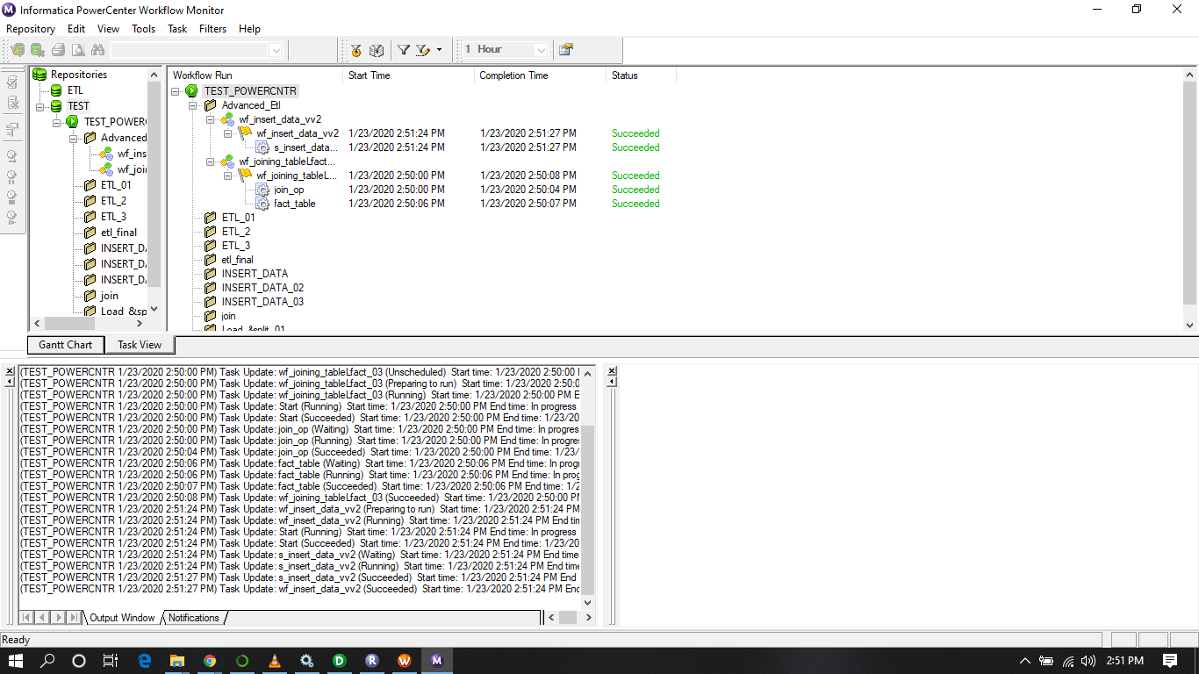
Parallel Processes Running Session

